Slide 1

What does it take to make Google work at scale?
CamSaS
Malte Schwarzkopf Cambridge Systems at Scale http://camsas.org – @CamSysAtScale

Slide 2
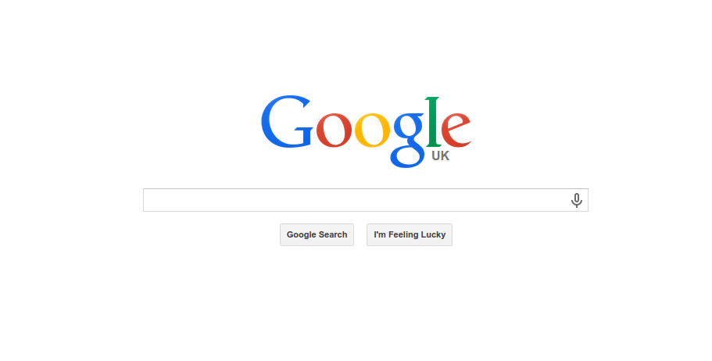

Slide 3
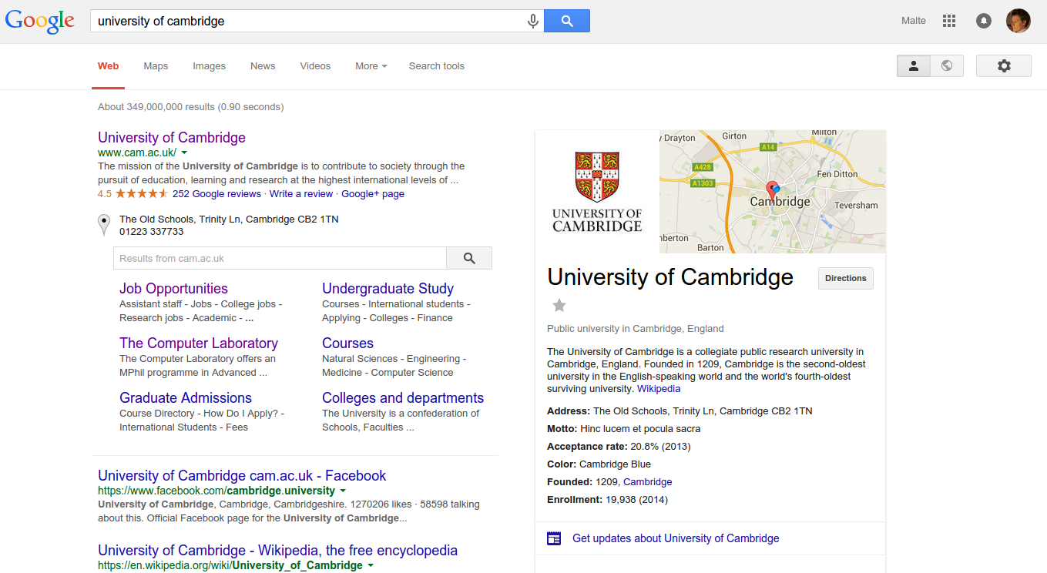

Slide 4
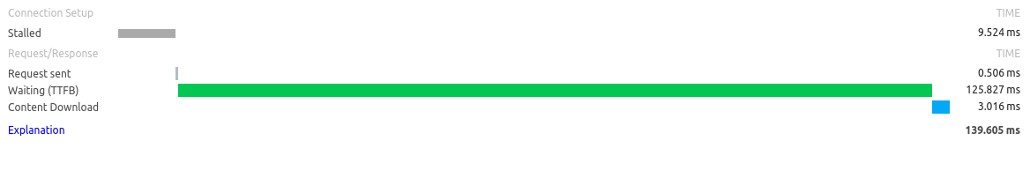
What happens here?

Slide 5
What happens in those 139ms?
Google datacenter
Internet
Your computer
?
?
?
Front-end web server
web idx
places idx
?
?
G+ idx
?

Slide 6
What we’ll chat about
Datacenter hardware
Scalable software stacks
Google
Facebook
Differences compared to HPC
Current research directions
Please ask questions - any time! :)

Slide 7
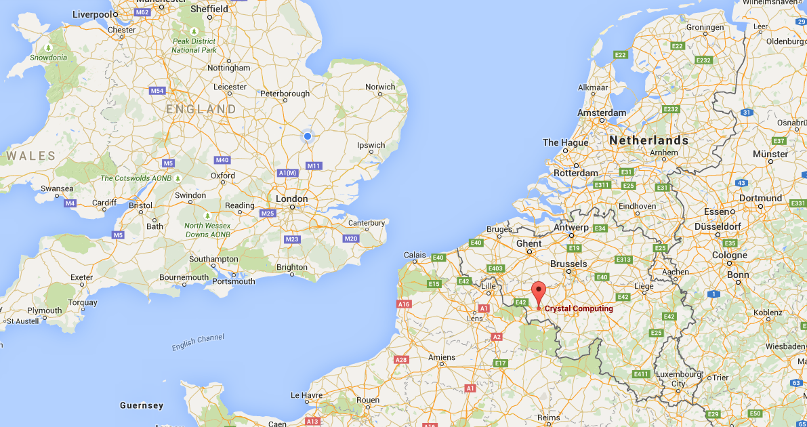

Slide 8
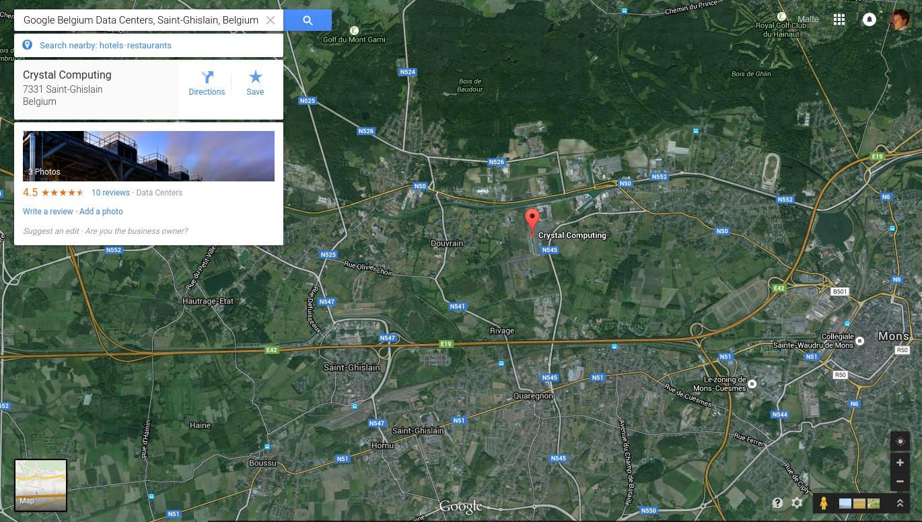

Slide 9
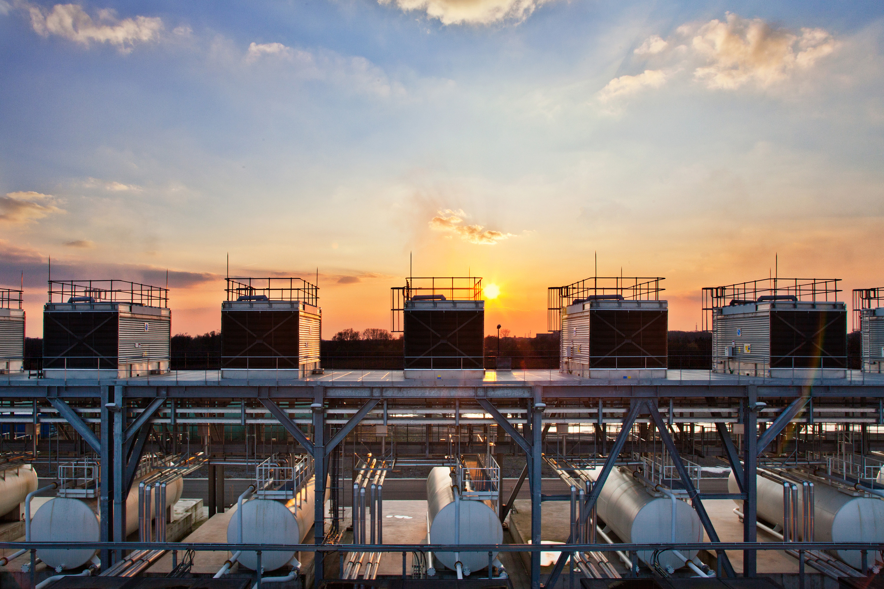

Slide 10
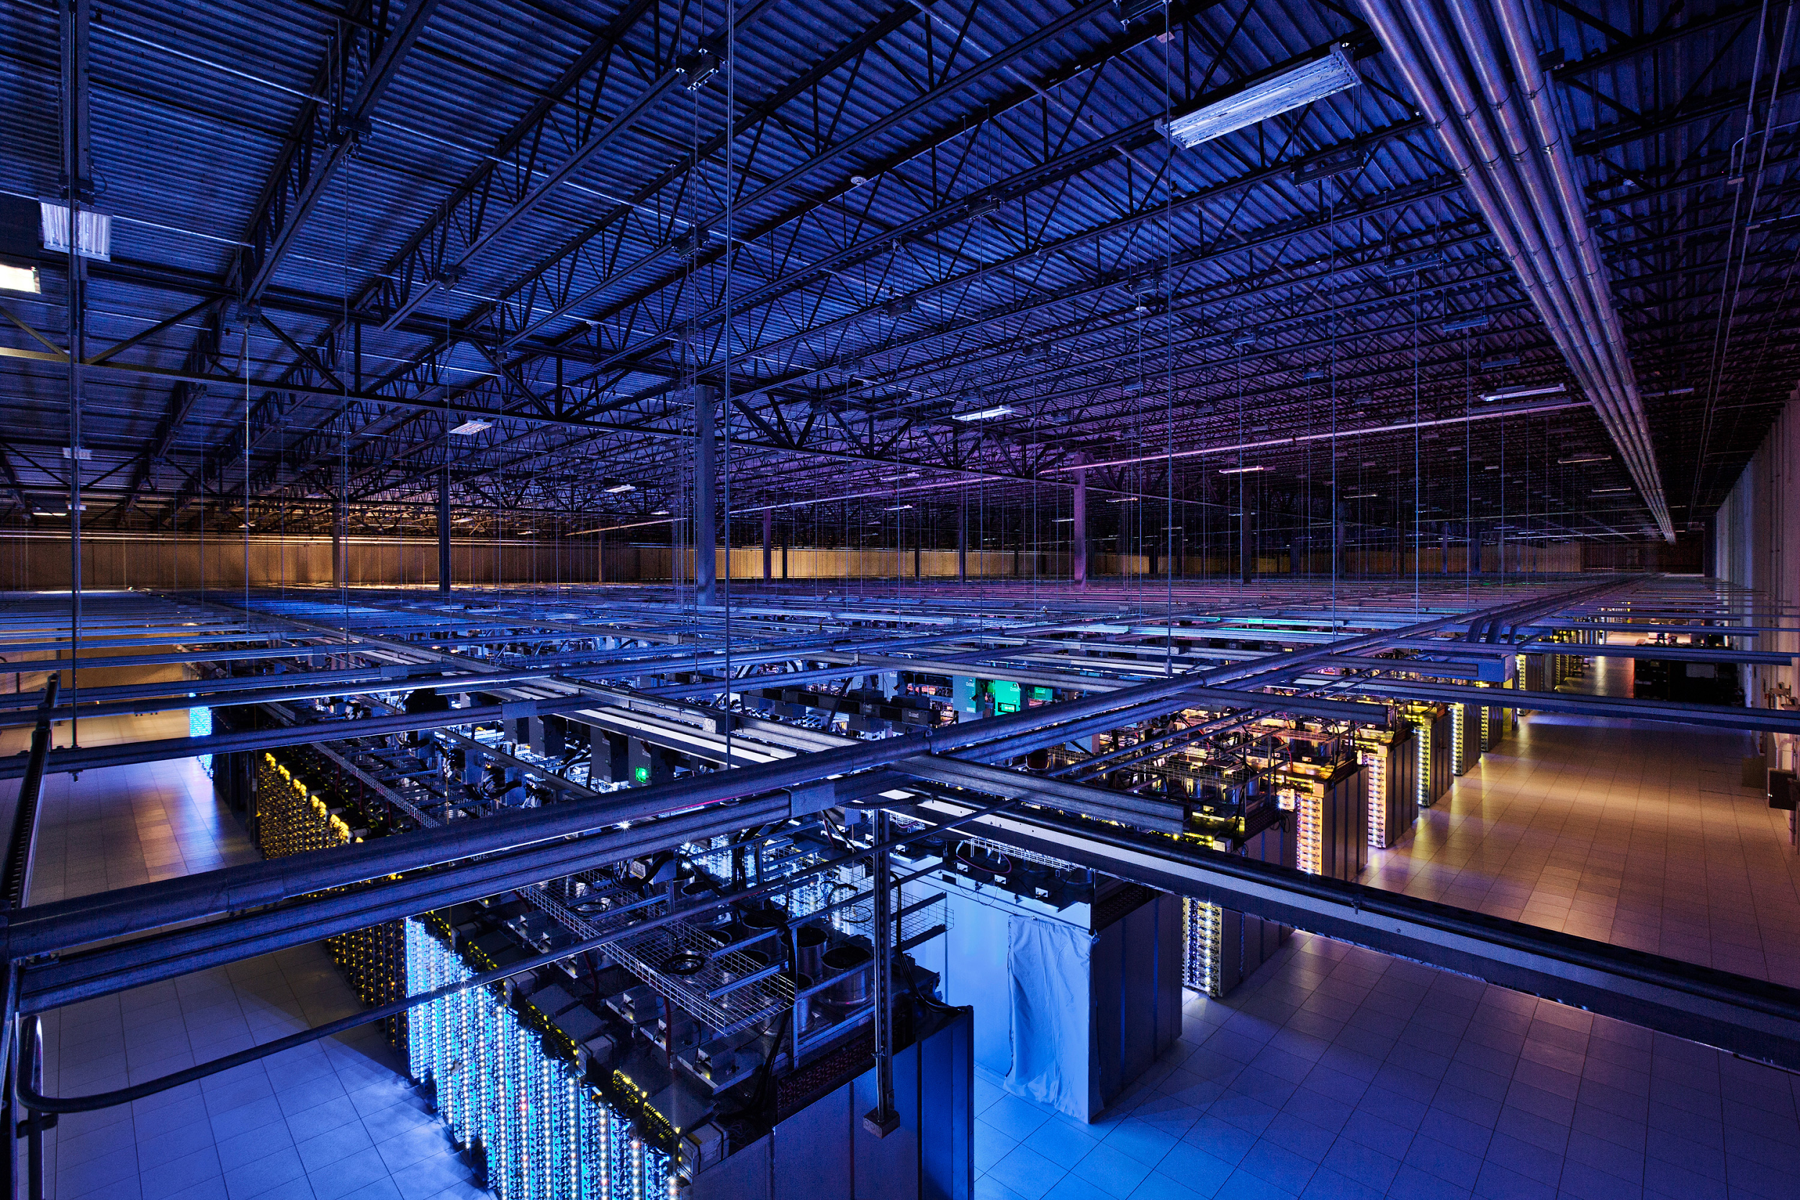

Slide 11
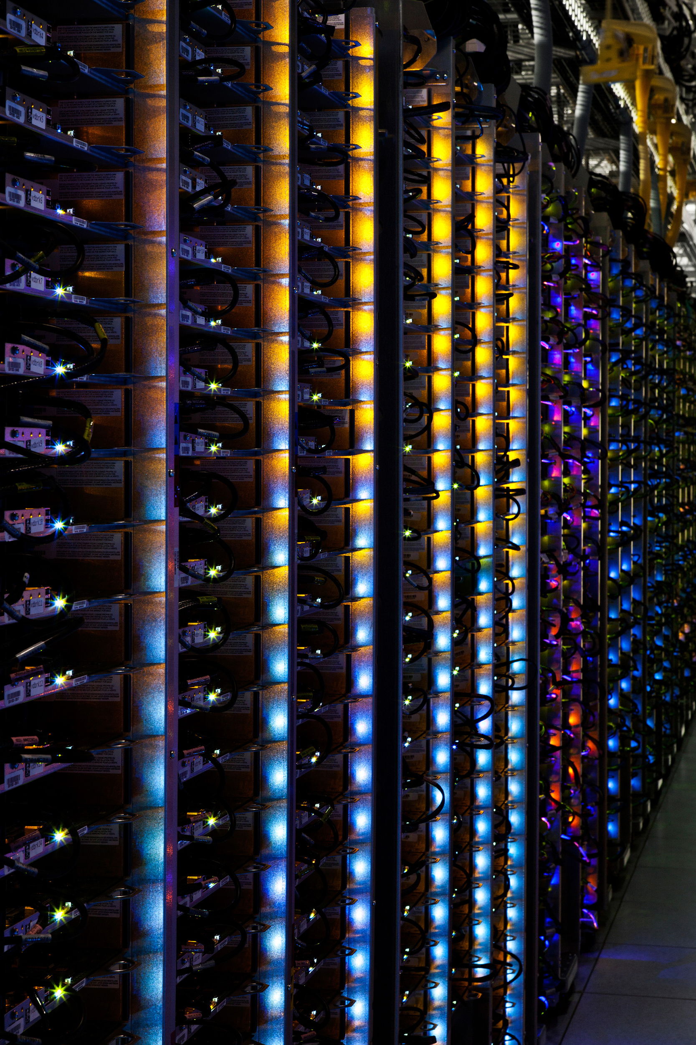
10,000+ machines
“Machine”
no chassis!
DC battery
~6 disk drives
mostly custom-made
Network
ToR switch
multi-path core
e.g., 3-stage fat tree or Clos topology

Slide 12
How’s this different to HPC?
Emphasis on commodity hardware
No expensive interconnect
Mid-range machines
Energy/performance/cost trade-off essential
Massive automation
Very small number of on-site staff
Automated software bootstrap
Fault tolerant design
Each component can fail
Software must be aware and compensate

Slide 13
The software side
Transparent distributed systems
We’ll look at what goes here!
Containers
Containers
Linux kernel (customized)
Linux kernel (customized)
Linux kernel (customized)
Machine
Machine
Machine

Slide 14
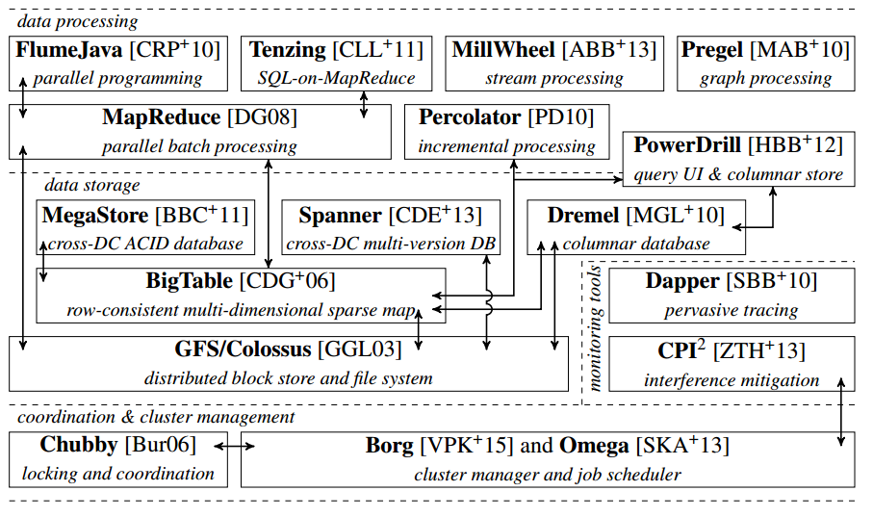
The Google Stack
Figure from M. Schwarzkopf, “Operating system support for warehouse-scale computing”, PhD thesis, University of Cambridge, 2015 (to appear).

Slide 15
The Google Stack
Figure from M. Schwarzkopf, “Operating system support for warehouse-scale computing”, PhD thesis, University of Cambridge, 2015 (to appear).

Slide 16
GFS/Colossus
Bulk data block storage system
Optimized for large files (GB-size)
Supports small files, but not common case
Read, write, append modes
Colossus = GFSv2, adds some improvements
e.g., Reed-Solomon-based erasure coding
better support for latency-sensitive applications
sharded meta-data layer, rather than single master

Slide 17
GFS/Colossus: architecture
Application
GFS library
GFS Master
Chunkserver
Namespace
Metadata
Chunkserver
Chunkserver

Slide 18
GFS/Colossus: writes
Application
GFS library
Chunkserver
GFS Master
Namespace
Metadata
Chunkserver
Chunkserver
Chain replication

Slide 19
The Google Stack
Details & Bibliography: http://malteschwarzkopf.de/research/assets/google-stack.pdf
Figure from M. Schwarzkopf, “Operating system support for warehouse-scale computing”, PhD thesis, University of Cambridge, 2015 (to appear).

Slide 20
BigTable (2006)
‘Three-dimensional‘ key-value store:
<row key, column key, timestamp> → value
Effectively a distributed, sorted, sparse map
cell
row (key: string)
<“larry.page“, “websearch“, 133746428> → “cat pictures“
timestamp (key: int64)
column (key: string)

Slide 21
BigTable (2006)
Distributed tablets (~1 GB) hold subsets of map
On top of Colossus, which handles replication and fault tolerance: only one (active) server per tablet!
Reads & writes within a row are transactional
Independently of the number of columns touched
But: no cross-row transactions possible
Turns out users find this hard to deal with

Slide 22
BigTable (2006)
META0 tablet is “root“ for name resolution
Like a coordinator/leader
Nested META1 tablets improve meta-data lookup
Elect master (META0 tablet server) using Chubby, and to maintain list of tablet servers & schemas
5-way replicated Paxos consensus on data in Chubby
Built atop GFS; building block for MegaStore
“Next gen” with transactions: Spanner

Slide 23
The Google Stack
Figure from M. Schwarzkopf, “Operating system support for warehouse-scale computing”, PhD thesis, University of Cambridge, 2015 (to appear).

Slide 24
Spanner (2012)
BigTable insufficient for some consistency needs
Often have transactions across >1 data centres
May buy app on Play Store while travelling in the U.S.
Hit U.S. server, but customer billing data is in U.K.
Or may need to update several replicas for fault tolerance
Wide-area consistency is hard
due to long delays and clock skew
no global, universal notion of time
NTP not accurate enough, PTP doesn’t work (jittery links)

Slide 25
Spanner (2012)
Spanner offers transactional consistency: full RDBMS power, ACID properties, at global scale!
Secret sauce: hardware-assisted clock sync
Using GPS and atomic clocks in data centres
Use global timestamps and Paxos to reach consensus
Still have a period of uncertainty for write TX: wait it out!
Each timestamp is an interval:
tt.earliest
tt.latest
Definitely in the past
t_{abs}
Definitely in the future

Slide 26
The Google Stack
Details & Bibliography: http://malteschwarzkopf.de/research/assets/google-stack.pdf
Figure from M. Schwarzkopf, “Operating system support for warehouse-scale computing”, PhD thesis, University of Cambridge, 2015 (to appear).

Slide 27
MapReduce (2004)
Parallel programming framework for scale
Run a program on 100’s to 10,000’s machines
Framework takes care of:
Parallelization, distribution, load-balancing, scaling up (or down) & fault-tolerance
Accessible: programmer provides two methods ;-)
map(key, value) → list of <key’, value’> pairs
reduce(key’, value’) → result
Inspired by functional programming

Slide 28
MapReduce
Input
Perform Map() query against local data matching input specification
Map
X: 5
X: 3
Y: 1
Y: 7
Shuffle
Aggregate gathered results for each intermediate key using Reduce()
Reduce
X: 8
Y: 8
Output
End user can query results via distributed key/value store
Results: X: 8, Y: 8
Slide originally due to S. Hand’s distributed systems lecture course at Cambridge: http://www.cl.cam.ac.uk/teaching/1112/ConcDisSys/DistributedSystems-1B-H4.pdf

Slide 29
MapReduce: Pros & Cons
Extremely simple, and:
Can auto-parallelize (since operations on every element in input are independent)
Can auto-distribute (since rely on underlying Colossus/BigTable distributed storage)
Gets fault-tolerance (since tasks are idempotent, i.e. can just re-execute if a machine crashes)
Doesn’t really use any sophisticated distributed systems algorithms (except storage replication)
However, not a panacea:
Limited to batch jobs, and computations which are expressible as a map() followed by a reduce()

Slide 30
The Google Stack
Details & Bibliography: http://malteschwarzkopf.de/research/assets/google-stack.pdf
Figure from M. Schwarzkopf, “Operating system support for warehouse-scale computing”, PhD thesis, University of Cambridge, 2015 (to appear).

Slide 31
Dremel (2010)
Column-oriented store
For quick, interactive queries
Row-oriented storage
Column-oriented storage
...

Slide 32
Dremel (2010)
Stores protocol buffers
Google’s universal serialization format
Nested messages → nested columns
Repeated fields → repeated records
Efficient encoding
Many sparse records: don’t store NULL fields
Record re-assembly
Need to put results back together into records
Use a Finite State Machine (FSM) defined by protocol buffer structure

Slide 33
The Google Stack
Details & Bibliography: http://malteschwarzkopf.de/research/assets/google-stack.pdf
Figure from M. Schwarzkopf, “Operating system support for warehouse-scale computing”, PhD thesis, University of Cambridge, 2015 (to appear).

Slide 34
Borg/Omega
Cluster manager and scheduler
Tracks machine and task liveness
Decides where to run what
Consolidates workloads onto machines
Efficiency gain, cost savings
Need fewer clusters

Slide 35
Borg/Omega
BorgMaster
BorgMaster
BorgMaster
Scheduler
Paxos-replicated persistent store
Link shard
Borglet
Borglet
Borglet
Figure reproduced after A. Verma et al., “Large-scale cluster management at Google with Borg”, Proceedings of EuroSys 2015.

Slide 36
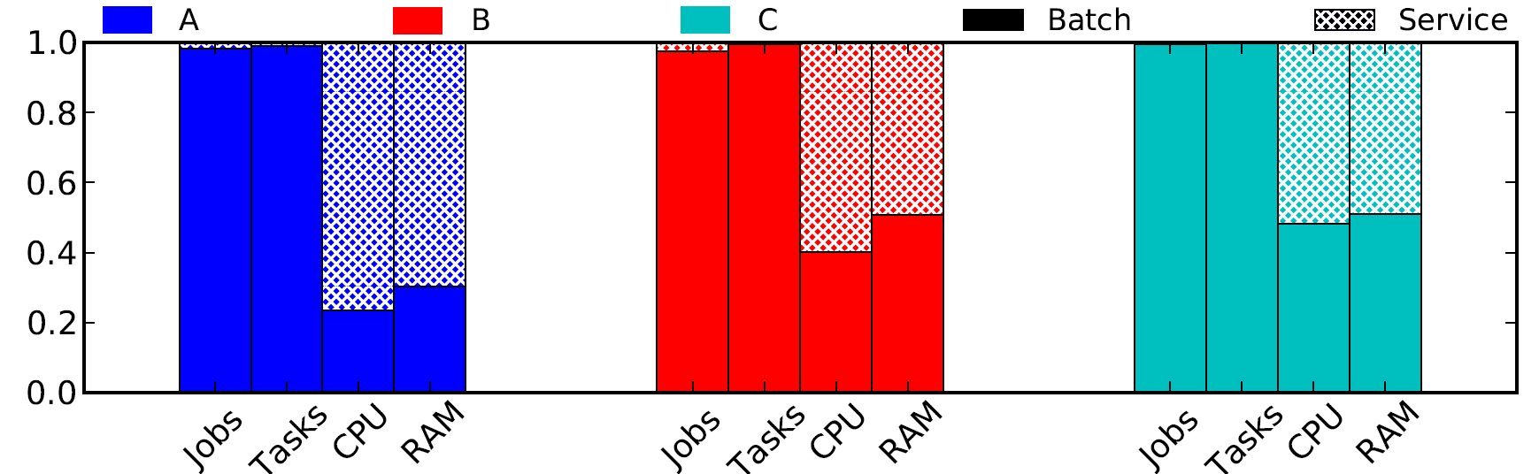
Borg/Omega: workloads
Cluster A
Cluster B
Cluster C
Medium size
Medium utilization
Large size
Medium utilization
Medium (12k mach.)
High utilization
Public trace
Jobs/tasks: counts
CPU/RAM: resource seconds [i.e. resource * job runtime in sec.]
Figure from M. Schwarzkopf et al., “Omega: flexible, scalable schedulers for large compute clusters”, Proceedings of EuroSys 2013.

Slide 37
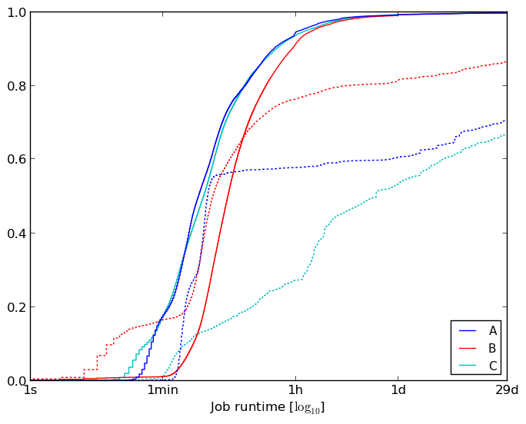
Borg/Omega: workloads
Service jobs run for much longer than batch jobs: long-term user-facing services vs. one-off analytics.
Fraction of jobs running for less than X
Figure from M. Schwarzkopf et al., “Omega: flexible, scalable schedulers for large compute clusters”, Proceedings of EuroSys 2013.

Slide 38
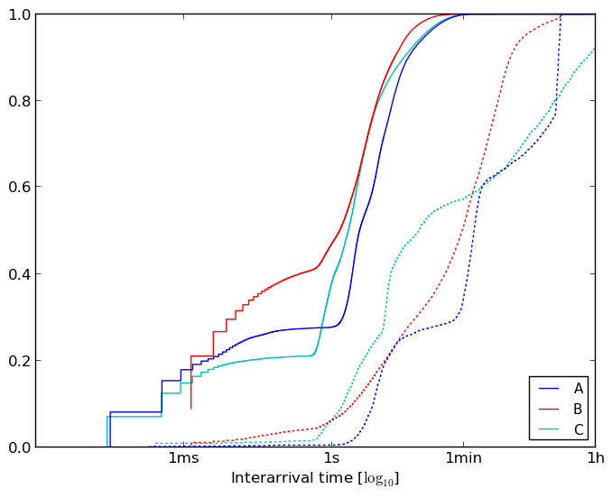
Borg/Omega: workloads
Batch jobs arrive more frequently than service jobs: more numerous, shorter duration, fail more.
Fraction of inter-arrival gaps less than X
Figure from M. Schwarzkopf et al., “Omega: flexible, scalable schedulers for large compute clusters”, Proceedings of EuroSys 2013.

Slide 39
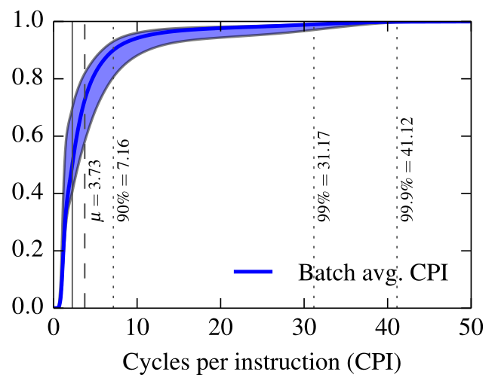
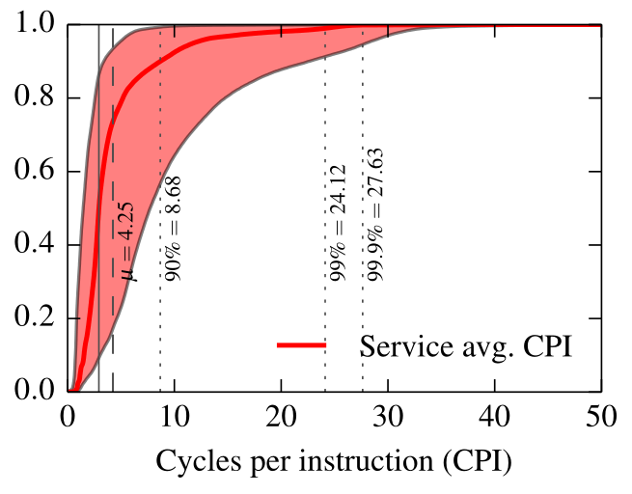
Borg/Omega: workloads
Batch jobs have a longer-tailed CPI distribution: lower scheduling priority in kernel scheduler.
Figures from M. Schwarzkopf, “Operating system support for warehouse-scale computing”, PhD thesis, University of Cambridge, 2015 (to appear).

Slide 40
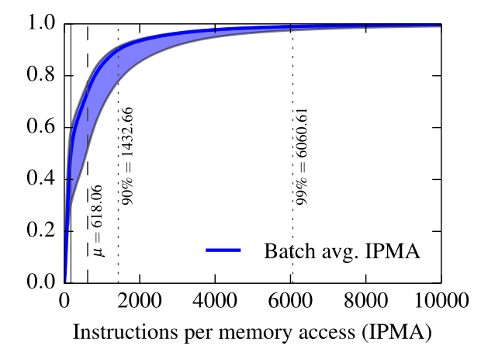
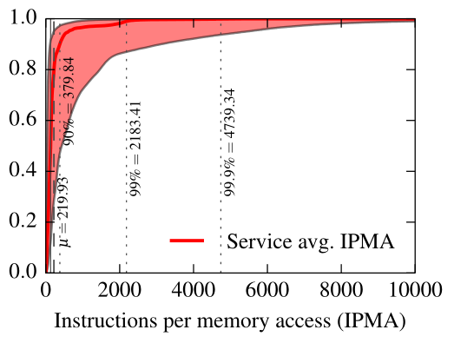
Borg/Omega: workloads
Service workloads access memory more frequently: larger working sets, less I/O.
Figures from M. Schwarzkopf, “Operating system support for warehouse-scale computing”, PhD thesis, University of Cambridge, 2015 (to appear).

Slide 41
How’s this different to HPC?
Generally avoid tight synchronization
No barrier-syncs!
Asynchronous replication, eventual consistency
Much more data-intensive
Lower compute-to-data ratio
Aggressive resource sharing for utilization

Slide 42
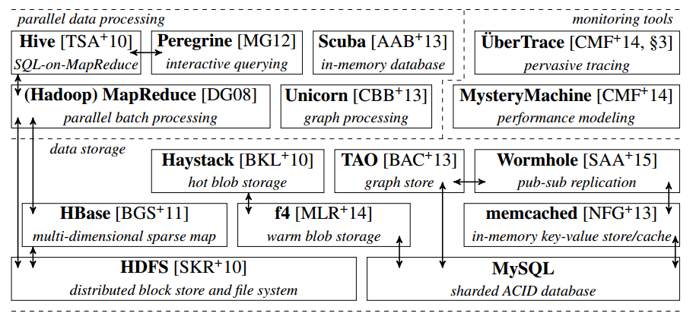
The facebook Stack
Details & Bibliography: http://malteschwarzkopf.de/research/assets/facebook-stack.pdf
Figure from M. Schwarzkopf, “Operating system support for warehouse-scale computing”, PhD thesis, University of Cambridge, 2015 (to appear).

Slide 43
The facebook Stack
MapReduce
BigTable
GFS
Details & Bibliography: http://malteschwarzkopf.de/research/assets/facebook-stack.pdf
Figure from M. Schwarzkopf, “Operating system support for warehouse-scale computing”, PhD thesis, University of Cambridge, 2015 (to appear).

Slide 44
The facebook Stack
Details & Bibliography: http://malteschwarzkopf.de/research/assets/facebook-stack.pdf
Figure from M. Schwarzkopf, “Operating system support for warehouse-scale computing”, PhD thesis, University of Cambridge, 2015 (to appear).

Slide 45
Haystack & f4
Blob stores, hold photos, videos
not: status updates, messages, like counts
Items have a level of hotness
How many users are currently accessing this?
Baseline “cold” storage: MySQL
Want to cache close to users
Reduces network traffic
Reduces latency
But cache capacity is limited!
Replicate for performance, not resilience

Slide 46
What about other companies’ stacks?

Slide 47
How about other companies?
Very similar stacks.
Microsoft, Yahoo, Twitter all similar in principle.
Typical set-up:
Front-end serving systems and fast back-ends.
Batch data processing systems.
Multi-tier structured/unstructured storage hierarchy.
Coordination system and cluster scheduler.
Minor differences owed to business focus
e.g., Amazon focused on inventory/shopping cart.

Slide 48
Open source software
Lots of open reimplementations!
MapReduce → Hadoop, Spark, Metis
GFS → HDFS
BigTable → HBase, Cassandra
Borg/Omega → Mesos, Firmament
But also some releases from companies…
Presto (Facebook)
Kubernetes (Google)

Slide 49
Current research
Many hot topics!
This distributed infrastructure is still new.
Make many-core machines go further
Increase utilization, schedule better.
Deal with co-location interference.
Rapid insights on huge datasets
Fast, incremental stream processing, e.g. Naiad.
Approximate analytics, e.g. BlinkDB.
Distributed algorithms
New consensus systems, e.g. RAFT.

Slide 50
Conclusions
Running at huge (10k+ machines) scale requires different software stacks.
Pretty interesting systems
Do read the papers!
(Partial) Bibliography:
http://malteschwarzkopf.de/research/assets/google-stack.pdf http://malteschwarzkopf.de/research/assets/facebook-stack.pdf
Lots of activity in this area!
Open source software
Research initiatives

Slide 51
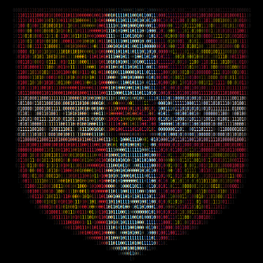
Cambridge Systems at Scale
@CamSysAtScale
camsas.org

